Slide 1


GROUP MEMBERS: IMMACULATE MWENDWA-669802 SYLVIA MULLA- 668830
EMPLOYEE PERFORMANCE DECISION SUPPORT SYSTEM

Slide 2
- This system helps organizations evaluate employee performance. - It uses data instead of opinions. - The goal is to make decisions fair, faster and more accurate.
Introduction

Slide 3
The Decision Problem
Subjectivity and Bias
Bias happens when managers can rate the same employee based on personal feelings
Inconsistency
Different managers can rate the same employee differently which leads to unfair results
Laborious
Manual evaluation wastes time that could be used for planning
Non-transparency
Employees don’t understand how they are judged which causes dissatisfaction

Slide 4
Decision Makers
Human Resource Managers
Monitor trends, identify weak departments, ensure unbiased evaluations.
Supervisors
Uses system data to support their decisions, recognize potential.
Executives
Monitor trends and decide if training programs are working

Slide 5

Inputs and Outputs
Attendance Rate
Measures how often an employee shows up to work
Completed Tasks
Number of assignments completed within timeframe. Shows productivity.
Productivity Score (0-100)
Numerical value representing work quality and efficiency
Supervisor Evaluation (1-10)
Qualitative assessment of cooperation and motivation.

Slide 6
Decision Logic

Slide 7
Decision Logic
This system uses a weighted scoring method- this means that each factor contributes differently to the final score
Attendance
Contributes 20%- this shows reliability but not the actual performance
Task Completion
Contributes 30%- This measures how much work an employee finishes
Productivity
Contributes 30%- This measures the quality and efficiency of the work
Adjusted Supervisor Rating
Contributes 20%- Adds the human judgment like teamwork
FOMULA
Performance Score = (Attendance × 0.2) + (Task Completion × 0.3) + (Productivity × 0.3) + (Adjusted Supervisor Rating × 0.2)

Slide 8
Quote
Decision Criteria
Above 80: High Performer – Promote
Acknowledge top talent and ensure retention.
60 to 80: Average Performer – Maintain
Meets requirements.
Below 60: Needs Improvement – Training required
Lacks certain skills.

Slide 9
DASHBOARD

Slide 10
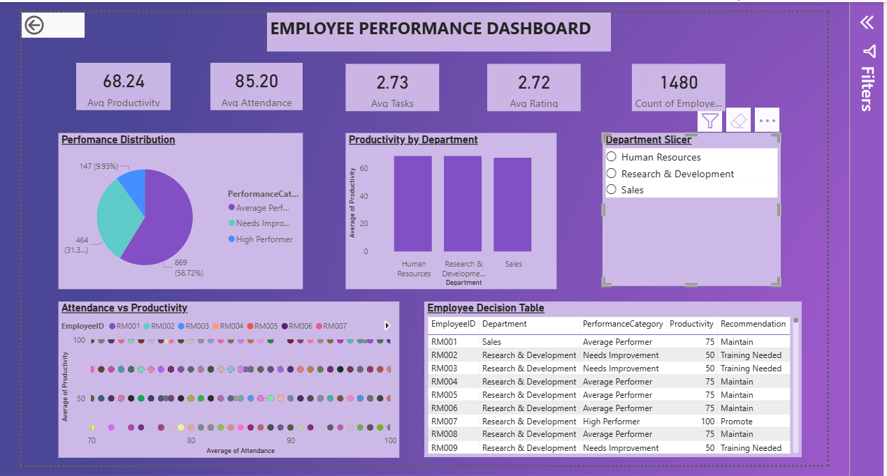
Dashboard Explanation
KPIs
- Total Employees, Avg Productivity, Avg Attendance, Avg Tasks, Avg Rating
Departmental Productivity (Bar Chart)
- Compares average productivity across departments
Attendance vs Productivity (Scatter Plot)
- Shows relationship between attendance and output
Performance Distribution (Pie Chart)
- Segments employees into High/Average/Improvement categories
Department Slicer
- Filter dashboard by Sales, R&D, or HR

Slide 11
Challenges experienced throughout the project
Data Preparation
Missing attendance variable required synthetic data generation.
Data Transformation
Converting ratings from 1-10 scale to standardized 0-100 scale.
Power BI Development
Fixed data aggregation errors and scatter plot configuration issues.
Compatibility
Resolved Power BI (.pbix) file sharing problems across team.

Slide 12
Strategic Impact & Future Vision - Transforms HR data into meaningful business intelligence. - HR personnel identify promotion and training needs quickly using Power BI dashboard. - Future enhancements: Real-time data feed, Attrition prediction, Peer review scorecard.

Slide 13
THANKYOU!

